Slide 1
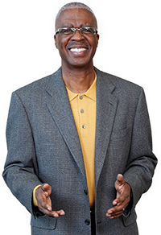
The Power of Attitude
Marvin Montgomery
AKA: “The Sales Doctor”
Get Marvinized!

Slide 2
LET’S START WITH A QUOTE:
“We cannot change the inevitable. The only thing we can do is play on the one string we have, and that is our attitude. I am convinced that life is 10% what happens to me and 90% how I react to it.
“And, so it is with you . . . we are in charge of our attitudes.”
Chuck Swindoll

Slide 3
Get Marvinized!
1. ATTITUDE IS A CHOICE

Slide 4
Get Marvinized!
2. MANAGE STRESS

Slide 5
Get Marvinized!
3. FOCUS ON THE POSITIVE

Slide 6
Get Marvinized!
4. PULL THE WEEDS

Slide 7
Get Marvinized!
5. KEEP IT FIRST-TIME FRESH

Slide 8
Get Marvinized!
6. BEND DON’T BREAK

Slide 9
Get Marvinized!
7. EXPECT THE BEST

